Slide 1
Road to 5k
sesto a. reborn

Slide 2
Theme
MOBA-style games and player behaviour
Character has a life outside of the game?
enables expansions!

Slide 3
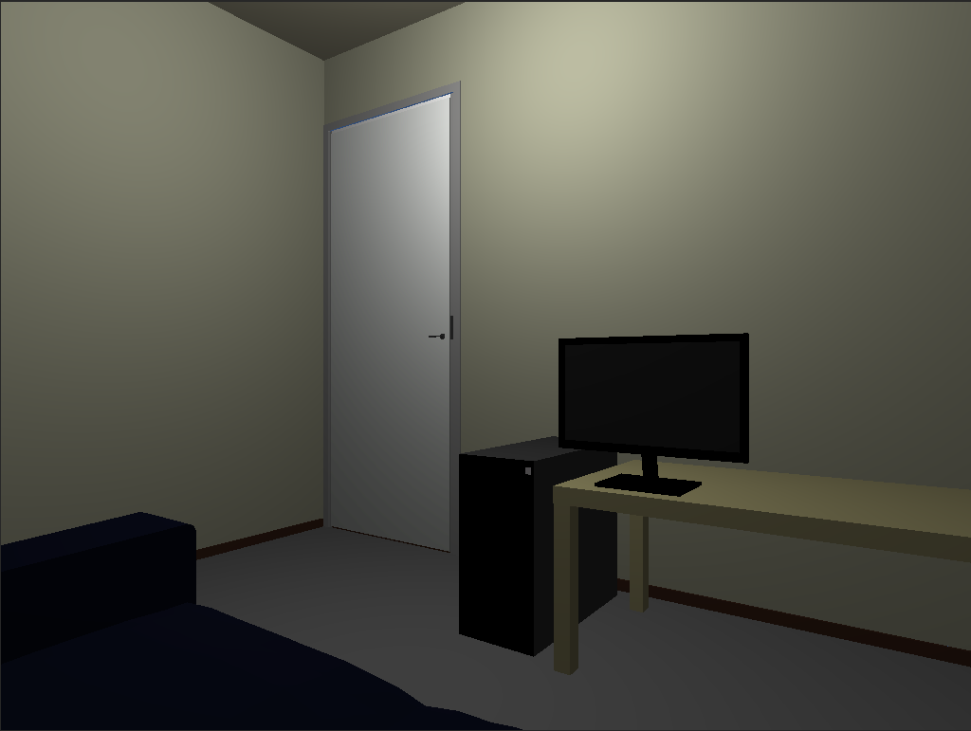
Art style & UI
Main view in 3D

Slide 4
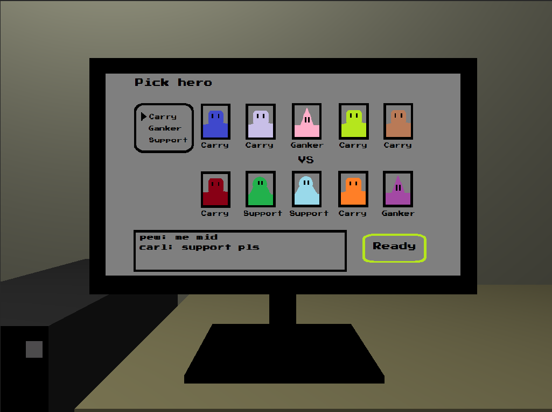
Art style & UI
MOBA-style game in 2D

Slide 5
Flow of playing a game of MOBA
Click screen
Click ‘Play a game’
Select hero type in pick screen
Follow JRPG-style match
Adjust behaviour (sliders)
Respond to events (dialog boxes)
Rage quit?

Slide 6
Flow of playing a game of MOBA
See final results
statistics
gained experience
reduction or increase of overall rage
reduction or increase of rating

Slide 7
Other features
Rage sounds
Chat
Skill tree
Game streams

